Slide 1
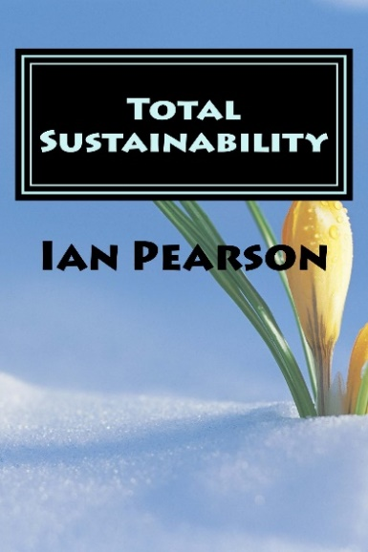
Dr Ian Pearson
A trip to the future
twitter.com/timeguide
timeguide.wordpress.com
www.futurizon.com

Slide 2
Disruptive v stimulative tech
Economicinfluence
Stimulative
technology
New tech disrupts old industries but it also stimulates new ones. We’ve probably already passed breakeven.
Disruptive
technology
2000
2020
2040

Slide 3
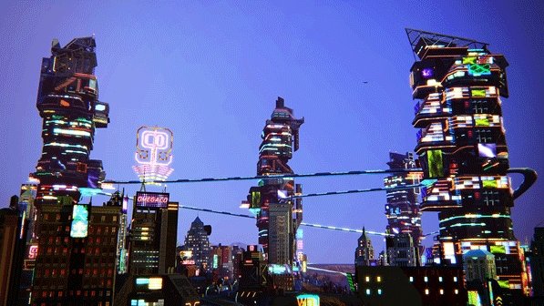
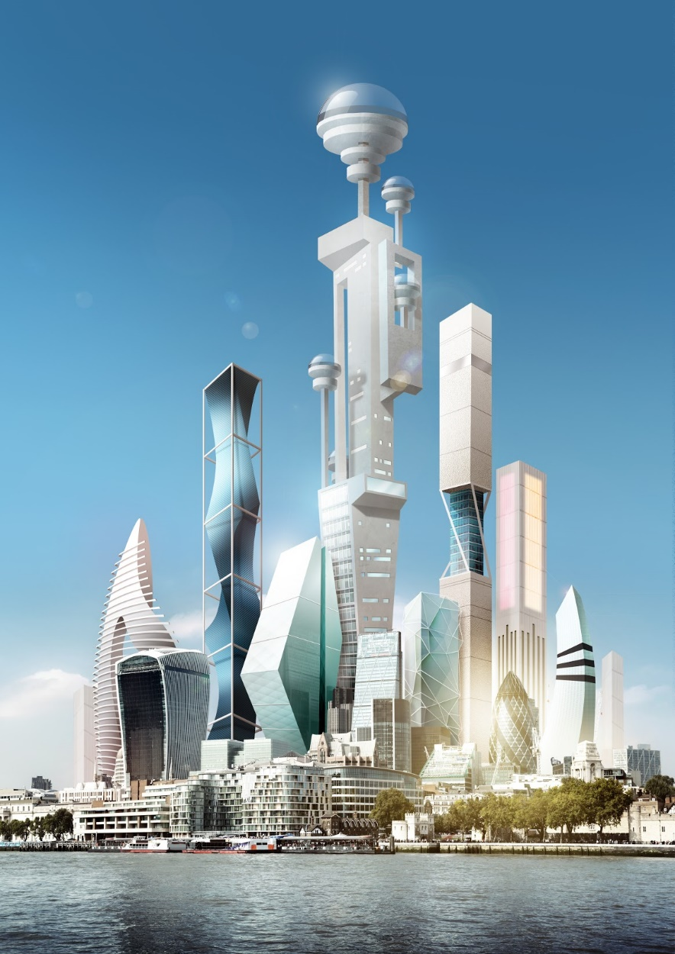
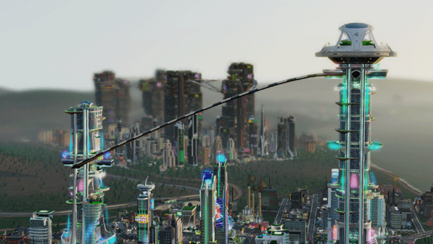
2050 Cities
30km tall spaceports
Residential buildings up to 10km, acting as small cities themselves
Residents may rarely leave them
Internal transport via lifts, moving walkways, skyways, bikes, pods, and outer surface transport
Notes:
5

Slide 4
Changing demographics
Re-migration
Ageing workforces
Emigration
Inter-generational conflict
Mobility and volatility
Brain drain
Immigration

Slide 5
Future residents won’t be just people
Intellectually enhanced pets and synthetic creatures
Transhumans and androids
NBIC enabled organisms, including transhumans
Natural world, including
Mk 1 humans
Cyberspace life, including conscious machines and superhuman AI

Slide 6
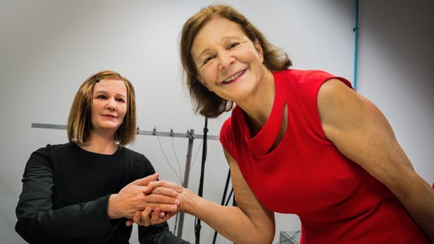
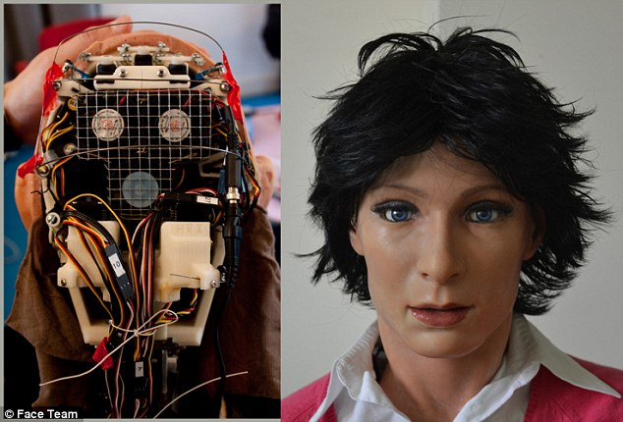
Androids will soon be part of society
Jia Jia, University of science
and technology of China
Nadine, NTU Singapore
FACE, Univ or Pisa
People will buy attractive robots for many purposes – interfaces, servants, friends, workers
They will inevitably form emotional relationships with them
Emotion-ready AIs will socialise with other AIs and other people too, not just their owners

Slide 7
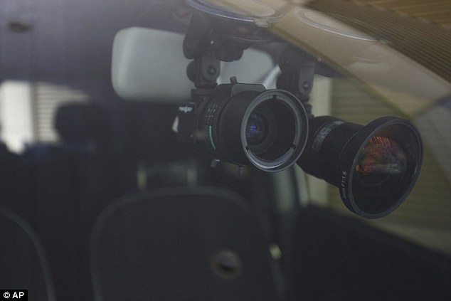
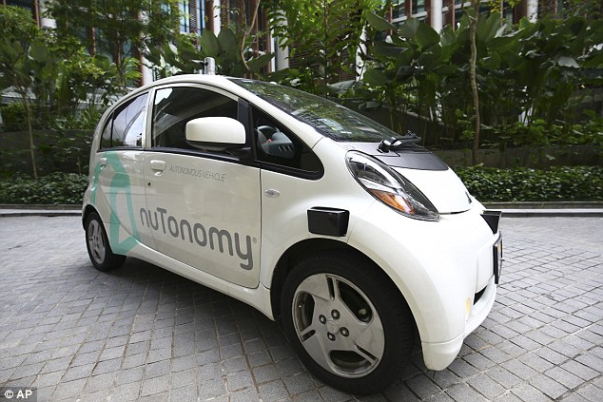
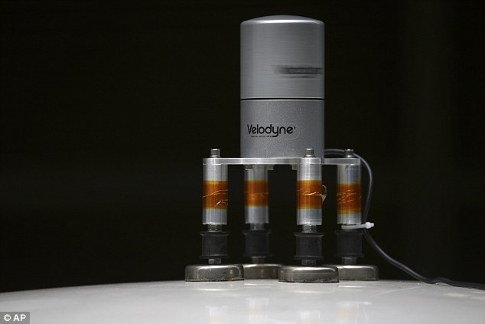
Singapore self-driving taxis

Slide 8
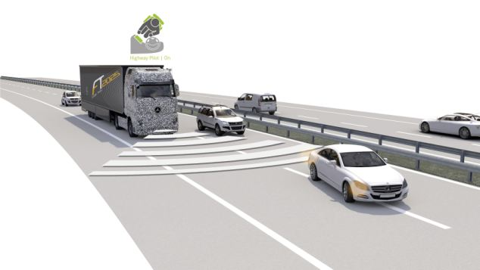
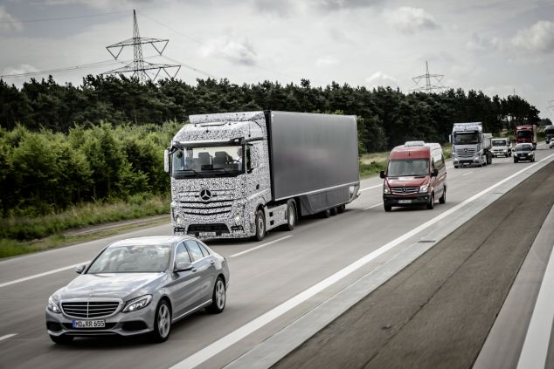
Mercedes self-driving truck 2025
Scans road 250m ahead. Driver still needed to supervise but can do admin
Good example of mixed human and machine-driven traffic
Eventually, human drivers may not be allowed on roads

Slide 9
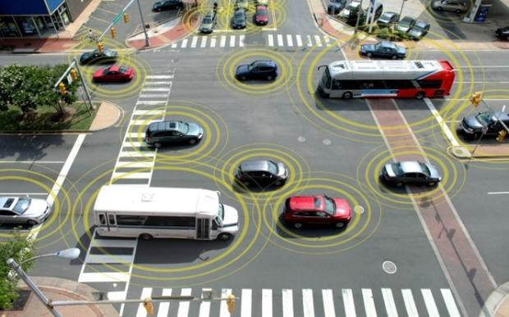
Vehicle IoT
In-vehicle Wireless Networks
Mobile net or Wireless LAN links to web and between clusters
Image ZDnet
Vehicles will be major networking locations, for IoT in the vehicle itself, driver comms & assistance, and entertainment and comms for passengers
Needs high B/W and fast and frequent handover. Security is a major issue. Current car IoT is very dangerous - provides easy hacking route. Imagine hacking a truck via net.

Slide 10
IoT : Ground-up data Clouds, tags, mobiles, sensor nets
Comms
Store
Processing
Sensor
Basis of smart transport systems
Ground-up data context for AI-based services
Self organising base for geo-AI
Big data will be replaced by biomimetic smart systems.
Creates ‘digital air’ AI channel between customer and suppliers
Sensor
Store
Tag
Sensor
Tag
Tag
Processing
Display
Display
Sensor
Comms
Store
Tag
Sensor
Comms
Processing
Tag
Sensor
Store

Slide 11
Car/Energy co-evolution
Renewable Energy
IT
Electric car batteries help make renewables workable. Electric cars work best in fleets. Also need right IT – clouds, sensor nets, smart meters, automatic drive
Energy will get cheaper. In 2030, oil will be equivalent of $30 per barrel in today’s money.
Electric car fleets

Slide 12
Fleet v private ownership
Private
Fleet
Control
Emotional connection
Automated driving
Energy synergy
Freedom
Status
Thrill
Sustainability
Price
Self expression
Social inclusiveness
Find another way to spend €5k/year

Slide 13
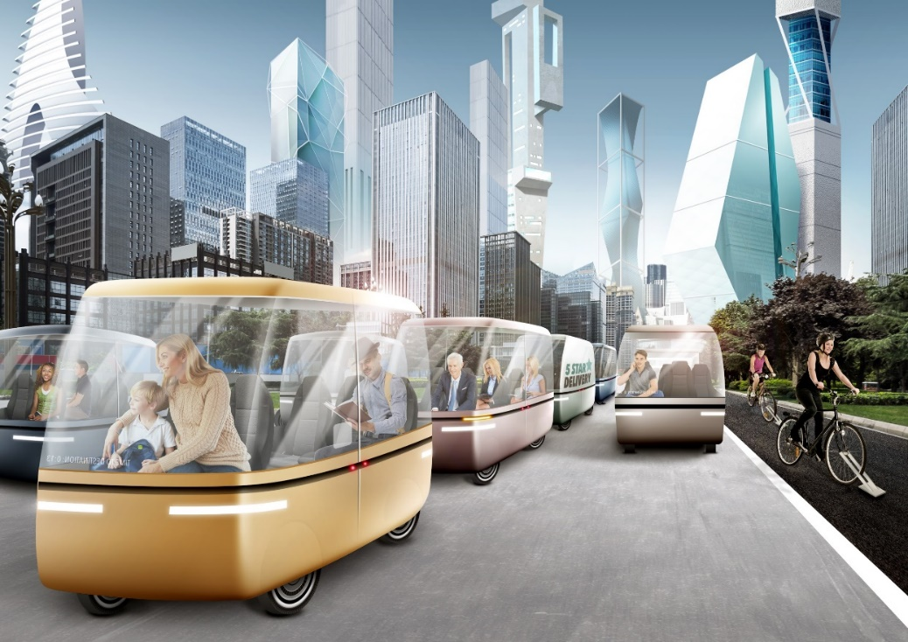
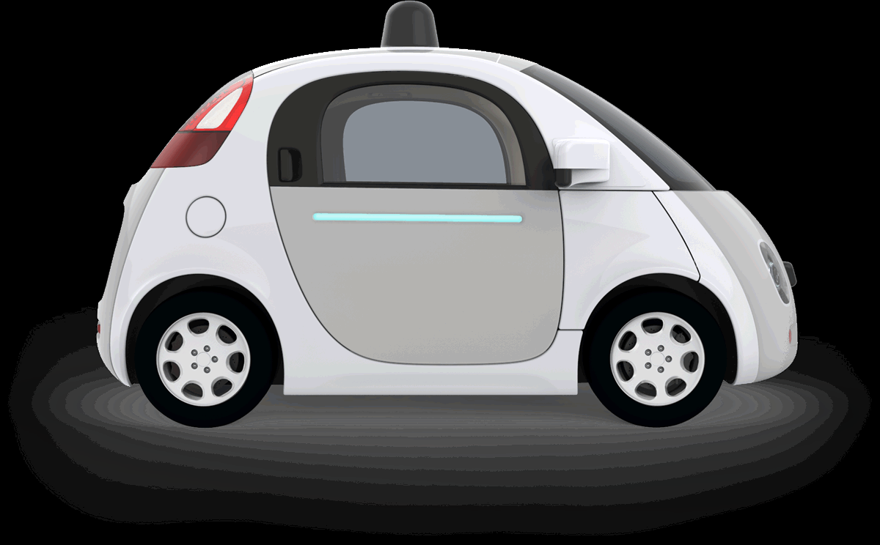
Familiar 2025 vision
Self-driving pods for transport and delivery
Glass and composite materials, with wheels, batteries, fuel cells or super-capacitors,
electric engines, AI & lots of IT
Notes:
5

Slide 14
2025 ‘Packetised’ rail travel
Electronic
tethers
Container
Town A
Town B
Shipping port
Town C
Current rail typically has only 0.5% track occupancy
Pods allow up to 95%, 200x higher rail utilisation
Pods assigned on demand, electronically driven and routed
Could evolve to eliminate tracks and trains and use electronically driven cars and lorries on any road surface
End-to-end socially inclusive public transport system
Could also run in Hyperloop-style systems

Slide 15
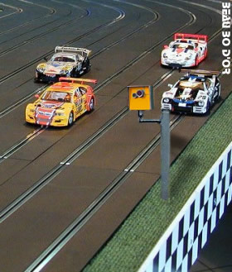
Alternative: Powered roads
Scalextric
Driverless pods with inductive power pickup
Inductive mats charge capacitors as vehicle passes over them
Linear induction motors pull pods & bikes along
Would mean NO demand to own or charge electric cars at home

Slide 16
Bicycle lanes could propel bikes Pearson 2005
On/off button
Metal plate and RFID chip
Linear induction motor mat stuck to road surface
Plate attached to front forks pulls bike & flips back if it hits an object

Slide 17
Vehicles with no moving parts Using magnetic well navigation Pearson 2015
Cars or transport pods travel mm apart, 15mm above surface
Control, payment, security and navigation all by mobile or cloud
Internal décor via augmented reality. Minimal electrics in pods.
Linear induction motor in road surface
Simple factory-produced mat laid out overnight

Slide 18
Graphene circuits will dominate when price falls
Reconfigurable circuits in the mat produce a powerful shaped magnetic well that propels pod and keeps it in correct position
Circuits at junctions change to route pods individually
Travelling shaped magnetic well
Copper wiring might tempt metal thieves but graphene circuits are far better electrically and offer poor resale value

Slide 19
Safe high speed
Zero friction levitation/propulsion/braking using EM coupling
Capacitance-based pedestrian detectors in mats
High friction pad engages for rapid stopping
Could safely drive in city at 85km/h
Levitation
Propulsion
Braking
High friction rapid stop surface

Slide 20
Pod tech for road or rail
Outer appearance chosen by occupants
Polymer display
Inner décor uses augmented reality
Virtual or real
windows
No wheels
EM levitation & propulsion
No battery, no motor
All self-cleaning/self sterilisation surfaces
Notes:
5

Slide 21
Freight could mix with pods
Local Delivery Pod
Shipping container
Freight crate
Local Delivery Pod
Passengers
Transporter platform
Robots
Local delivery platforms
Same system could work for road and rail
Shipping containers carried on transporter platforms
Local delivery pods could be stacked or merged to make larger containers
Automated delivery service for shopping, food, parcels, other goods
Cheap delivery acts as stimulator for latent businesses

Slide 22
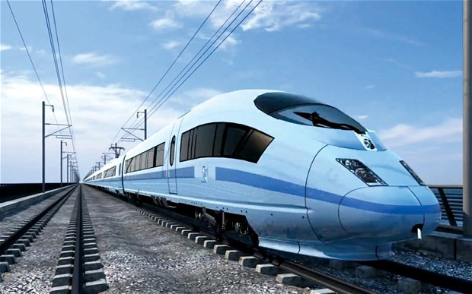
HS2 v Hyperloop v pods
HS2 is 20th C tech
Hyperloop high speed but expensive
Scheduled service would add delay
Pods need no rails, could be fully compatible with road pods for no-delay end to end travel
Pods could be high speed
Pods could interleave with freight carriers on same lanes

Slide 23
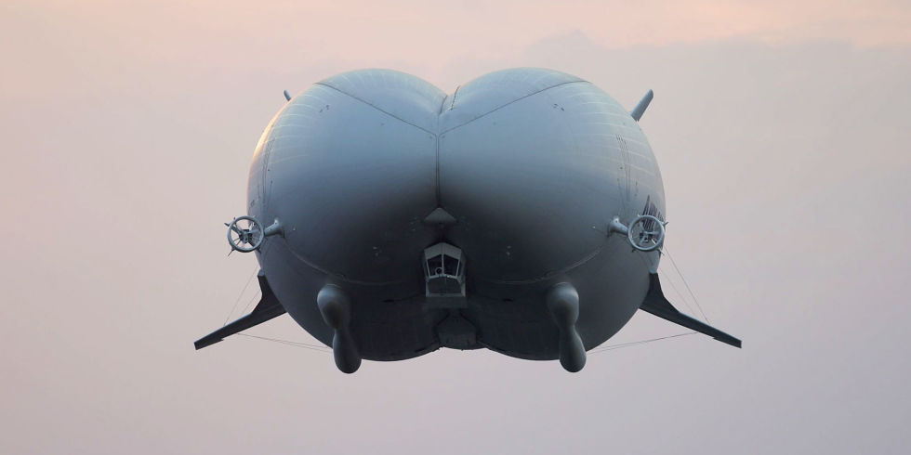
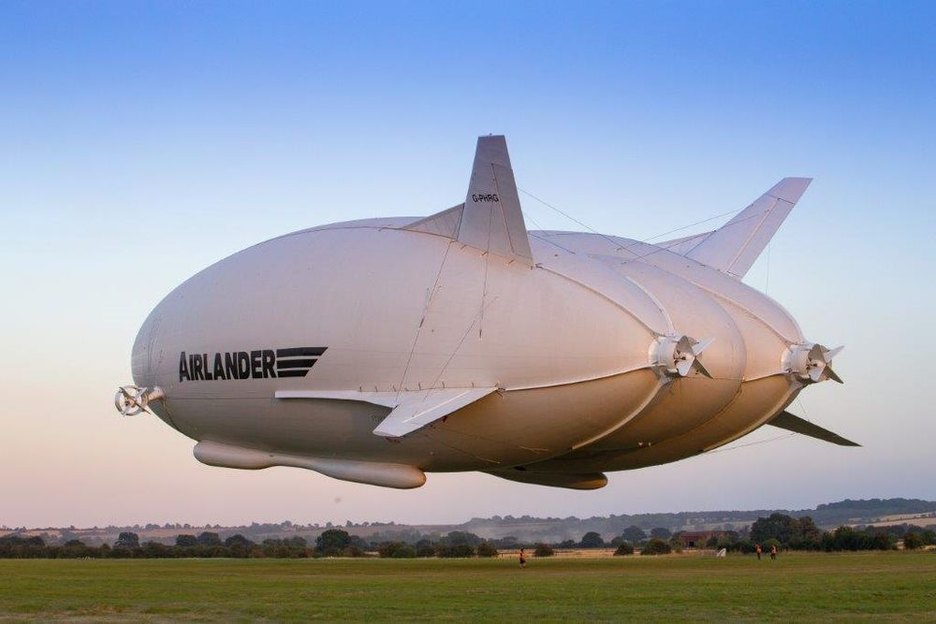
Other freight: Airlander airship
92m long and helium filled
Flies at 4900m altitude at 150kph for up to 2 weeks in the air
Prototype carries up 10 Tons
2020 version will carry 50 Tons

Slide 24
2030 - Solid balloons
Any shape any size
Carbon foam is lighter-than-air material made of tiny graphene spheres with vacuum inside, up to 2000Bar strength
Could be a permanent base for ultra-fast laser comms
Airships for freight, commuting, tourism and temporary structures for residence or functions
Far safer and more versatile for drone construction than propellers
Could also be used as escape pods for tall buildings

Slide 25
Micro-reactive self-sterilising surfaces Pearson 2016
Sides pushed up
Polymer ‘muscle’ contracts
Millions of tiny structures or micro-needles embedded in surface
As voltage is applied across electro-active polymer, it contracts, pulls base together and pushes peak up to rupture bacteria or loosen dirt particles
Nanostructures kill bacteria or shed dust and dirt
Alternatively, a tuned acoustic wave could push out needles in waves
Could be used for hard surfaces or smart packaging

Slide 26
UV surface cleaning system
Detect human or pet presence
Directed UV sterilisation from
drones or robot attachments
Base sterilisation from UV lights
Chemical free cleaning of rooms while empty. Works well with self-cleaning fabrics too. Next generation may use plasma.

Slide 27
AR Enhances the real world
Hi-res, 3D AV overlays for email, leisure, socialisation, navigation, business, shopping
Enhances every aspect of travel
Dual appearance
Games, TV or ads blended into real world lifestyles
You choose how you appear in the virtual world
Everyone sees world differently
Fight off aliens while your partner chooses an outfit

Slide 28
Rising AI & the Care Economy
Value of
physical/
intellectual
work as AI develops
Value of human skills &
personal contact
time
More face to face interaction to deliver emotional and ‘human’ skills

Slide 29
Changing nature of work
AI will automate some everyday tasks.
This frees people to do more ‘people stuff’
Work will mostly be people oriented – a care economy
Needs close emotional contact, often face to face
More local travel to deliver personal services face to face
Robotics automates manufacturing, assembly and distribution.
Distribution will become cheaper so will stimulate new businesses
3D printing and ‘part-bake’ will allow cottage industry to flourish again
Co-ops, collectives, and informal collaborations of freelancers will exist alongside traditional companies

Slide 30
Upskilling v Redundancy
Access to knowledge
Ubiquity
People become more capable, more productive
Search & analysis tools, data mining
Natural language interaction
Need fewer people for same work
AI processing,
Ground-up data
Do you want fewer people or better people?

Slide 31
Part-reversal of globalisation
Machine intelligence changes nature of work
Protectionism & regionalisation returning
Potential for virus outbreaks forcing travel constraints
Carbon economics dictates less global transportation
Global arrangements for most things, but work and consumption patterns will be increasingly localised
Many things increasingly globalised
2010
2015
2020
2025

Slide 32
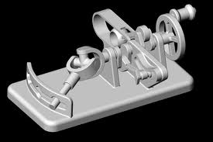
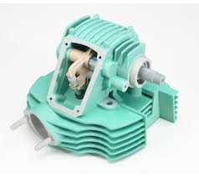
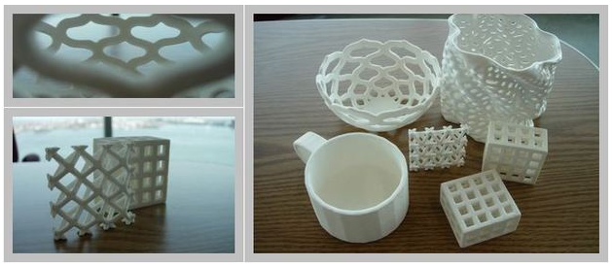
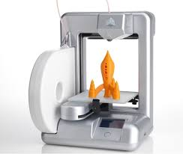
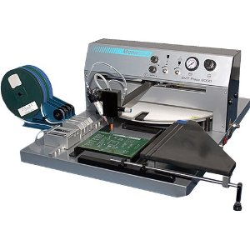
3d Printing stimulates local manufacture
+
Beware of overhype!
High street pick & place 3d printing hybrids will soon make complex artefacts containing a wide range of IT & mechanics

Slide 33
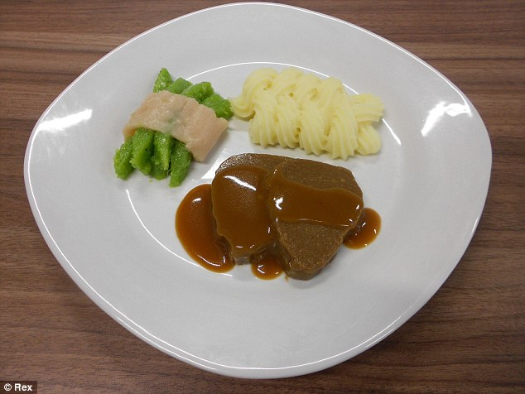
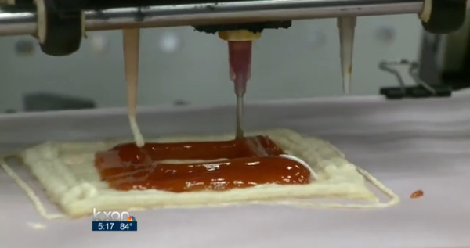
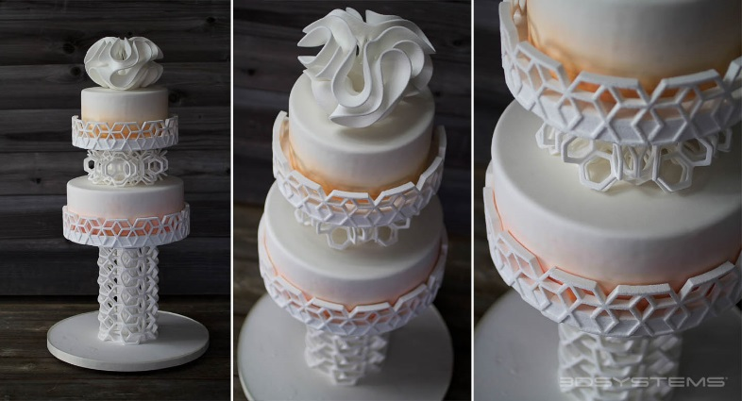
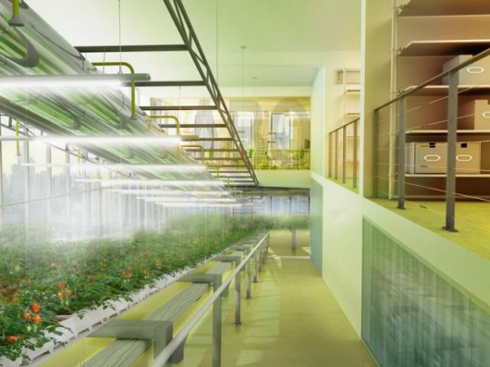
Home business food production & 3D printing
3D printing is useful for some things. Makes sense for decorations, novelties & sweets, less suited to everyday foods or meals.
3ders.org
Sugar Lab
Pick and place robotic assembly may hybridise with 3D printers soon and that will be much better!
Vertical farms & hydroponics

Slide 34
Enables cloud food production
Amazon
Energy & CO₂ producers
Lab-grown foods
Bio/pharma
Big & small Retailers
Traditional Processors
Social web marketing
Hydroponic greenhouses
Farms
Farm shops
Local markets
Home
growers
Cottage industry
Smallholdings
Personal collection
Virtual allotments
Store delivery
Delivery alliances
Man & Van

Slide 35
Home Delivery Innovation Smart local storage, distribution, collection & services
Supplier
Local shop,
post office,
or courier
On
request
Home &
Cottage
Industry
Any
time
Any
time
Any
time
Regional
warehousing

Slide 36
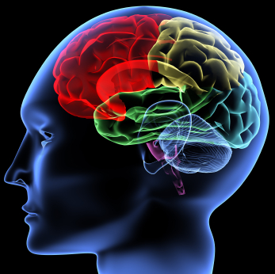
Finally, by 2050 people can use net-brain links to communicate or travel
Medium
So why travel?
Billions of tiny sensors linked to every synapse, signalling activity to external replica and able to recreate signals generated by external replica
People will communicate directly by thought, mediated by net link. They will share senses and consciousness and be able to inhabit androids for remote presence

Slide 37
Thank you
Ian Pearson Bsc DSc(hc) CITP FBCS FWAAS FRSA FWIF
idpearson@gmail.com
www.futurizon.com
twitter.com/timeguide
timeguide.wordpress.com
Coming soon

